Slide 1
Dr. Mark Eckel, The Comenius Institute

Slide 2
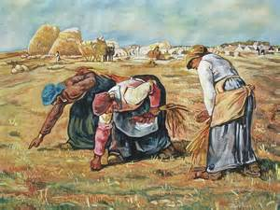
Our abilities, whatever they may be, are God-given.
Our work, no matter what we do, matters to God.
Our jobs, well done, show our love for others.
Vocation IS Ministry

Slide 3
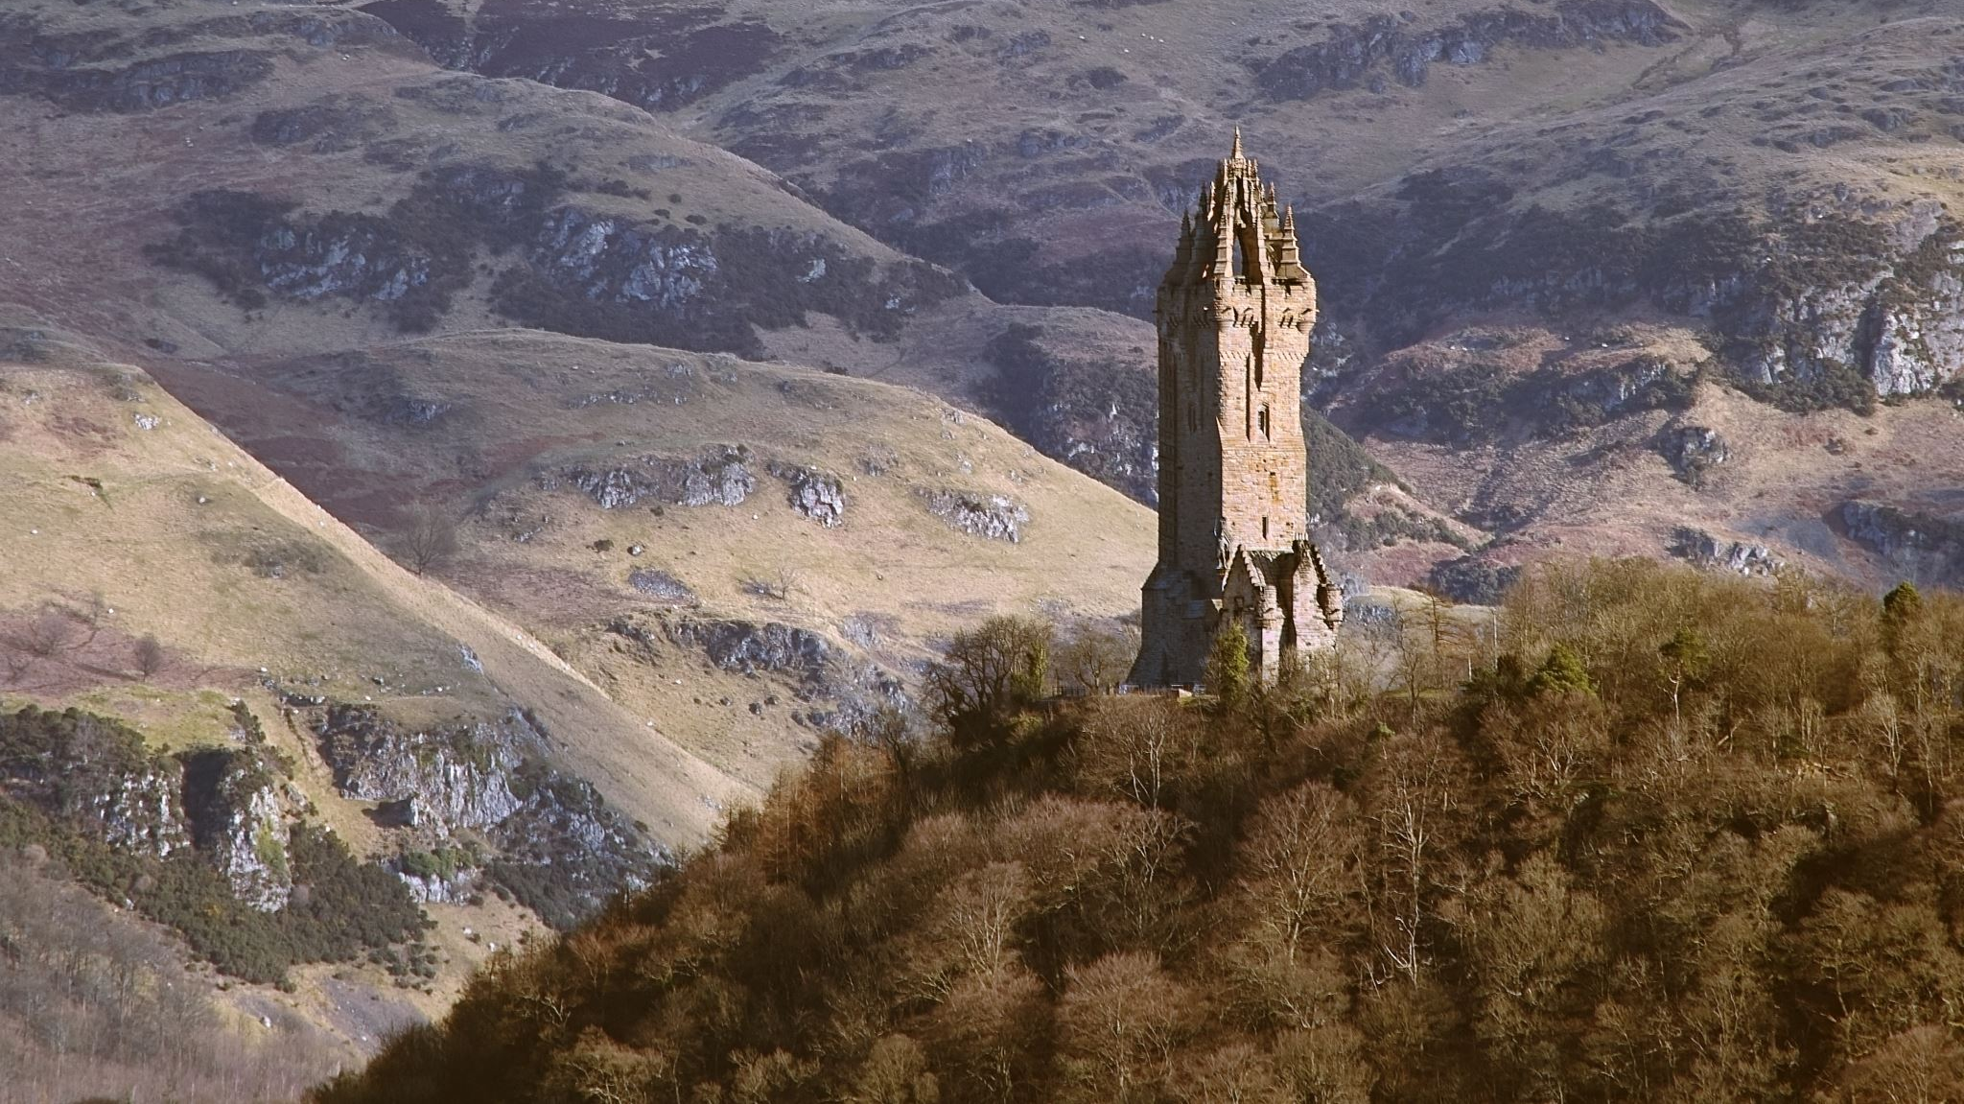
Everything is Sacred
Gnostic View Hebraic-Christian View
“Secular”
God is the originator, the sustainer of all things, nothing is “secular” - therefore, all things are sacred
Sacred

Slide 4
In All Things may God be praised (1 Peter 4:11)
He gives life to All Things (Nehemiah 9:6; 1 Tim 6:13)
He gives us All Things (Acts 17:25; 2 Peter 1:3 “for life”)
All Things are created for, by, & through (Prov 16:4; Col 1:16)
He is upholding All Things by the word of His power (Heb 1:3)
He is before All Things, by Him All Things consist (Col 1:17)
Through Him to reconcile to himself All Things (Col 1:20)
In All Things He might have preeminence (Colossians 1:18)
Until the time comes for God to restore All Things (Acts 3:21)
He will make All Things new (Revelation 21:5)
All Things for us to enjoy (1 Timothy 6:17)
Give thanks for All Things (Ephesians 5:20)

Slide 5
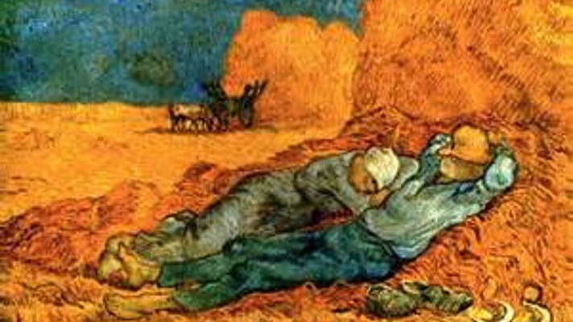
George’s life, well lived
Rest from work
Part one

Slide 6
Pig Roast: Time can be saved
Be careful not to sacrifice what is important
on the altar of insignificance

Slide 7
Introduction Cultural comparisons: work and leisure
Work = we identify ourselves by what we “do”
Leisure = we work for money and try to buy rest

Slide 8
Leisure: The Basis of Culture
“Religion can be born only in leisure -- a leisure that allows time for the contemplation of the nature of God. issues a startling warning: Unless we regain the art of silence and insight, the ability for non-activity, unless we substitute true leisure for our hectic amusements, we will destroy our culture -- and ourselves.”

Slide 9
Retreat is not a luxury. Retreat is an expectation. Retreat is an act of worship. Retreat is the anticipation of eternity. Retreat is not something we work into our schedule, our schedule should work around retreat. To think that we can honor the Creator by carving out time for retreat is burning the house to barbeque a pig. We must not offer what is important on the altar of insignificance. READ Hebrews 4:1-10.

Slide 10
Genesis 1:31-2:3 Historical, cultural, geographical background:
Creation:
In Israel, God orders creation;
In pagan religions, creation gives order

Slide 11
Historical-Cultural Background: Rest
Babylon/Assyria
7-day cycles = bad luck;
Israel not tied to heavenly cycles
“7” = completion

Slide 12
God established rhythmic, patterned ordinances
God’s blessing embedded in creation
1:22 Reproduction
1:28 Rule
2:3 Rest
Pagan cultures sanctified space (a place), Israelite culture sanctified time

Slide 13
Rest is Embedded in Creation
Mitosis
Other blessings commanded; this blessing reported
“Time” is beyond human control
God called creation “good”; but “time” was sanctified, holy

Slide 14
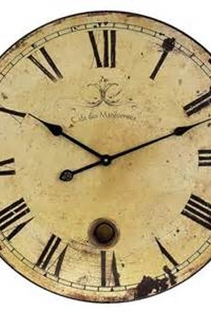
Rest = Heaven Woven within Earth
“Every tick of the clock brings you one second closer to death”
“HOLIday”
Teens-don’t rush
Young-rest patterns
“35” = half
“old” Psalm 92
“Redeem” Eph 5.16

Slide 15
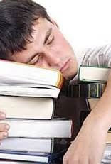
Creation Works in Agreement with our Daily Lives
One third of our lives spent sleeping
Preteens 10-12
Teens 10
Adults 7-8

Slide 16
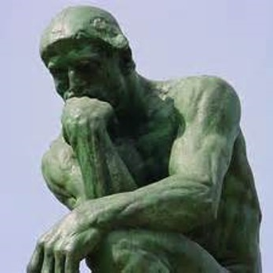
“Finished” 2:1-2
“finished” = to bring a process to completion; break the pattern; order and significance is given to the week by resting/stopping
Ecclesiastes 2:24-26; 3:11-13; 5:18-20
Freedom from production, acquisition, “getting”
I have to stop thinking

Slide 17
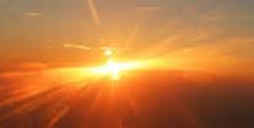
“The work, All the work, All the creation work”
2:2-3 [in Hebrew]
“the work He had done,” “from all the work He had done,”
“from all the creation work He had done”
(1) suspension of physical creation;
(2) rest is goal of creation;
(3) rest is a marker of the world yet to come (Heb 4:9-10)
We were made for eternity

Slide 18
Eternity is the goal of creation We were made for eternity
Life is hard; it was not intended to be so
We look forward to eternity because we were made to rest, we were created to be timeless without suffering

Slide 19
“Rested” 2:2-3
a state of cessation because of accomplishment, achievement implying celebration; the seventh day gives significance to all the others
The weekly day of rest has no parallel in any other ancient civilization
[view a job well done]

Slide 20
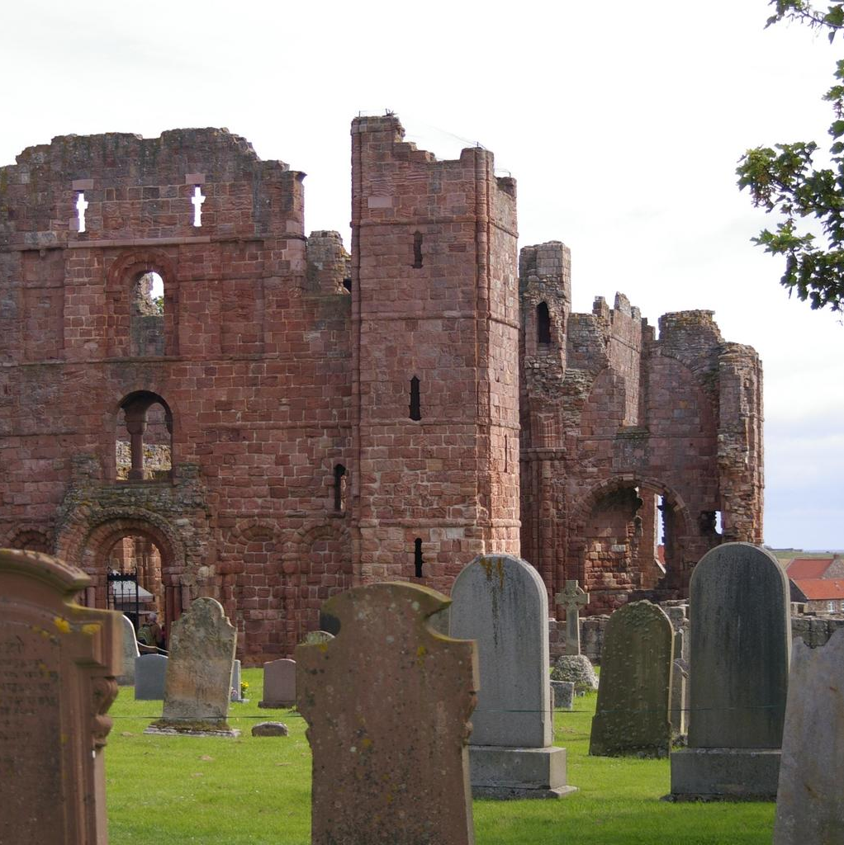
Monasticism, Scholasticism, and “Cathedral Schools”
Charlemagne, 8th C.
“So children can learn to read; that psalms, notation, chant, computation, and grammar be taught”
[Handout]
“Homeschooling”

Slide 21
The Seventh Day Gives Significance to Every Other Day
God gave a special day
Since all people are made of clay
So that believers could pray
And all people could play

Slide 22
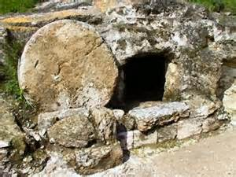
Sabbath ≠ Sunday
Sabbath = rest
Next week, more on whether the day itself matters

Slide 23
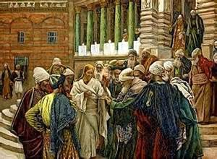
Jesus and the Sabbath
Jesus reemphasizes the significance of Sabbath by infusing Sabbath rest INTO people.
Jesus was always ticking people off by doing or saying things other than the way people thought they should be.

Slide 24
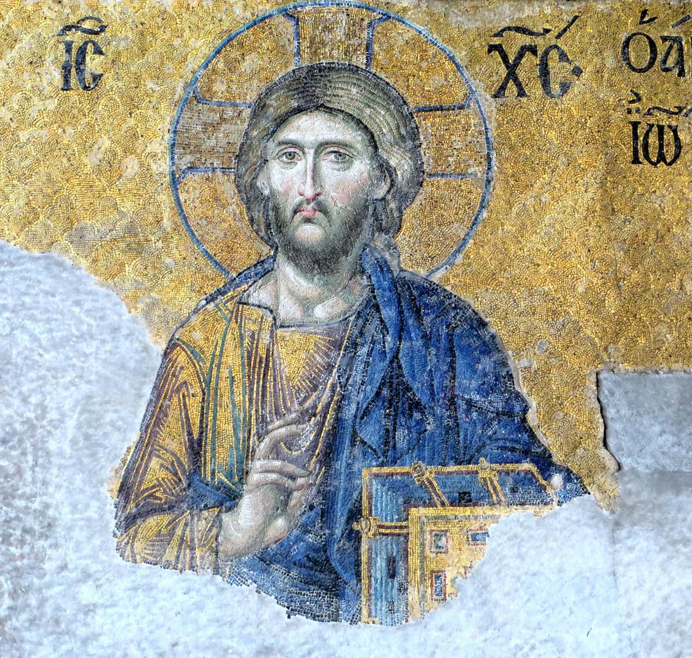
Mark 2:23-28 Jesus is Lord of Sabbath; Creator; righting a wrong world Mark 3:1-6 Sabbath is for human benefit; restoration; a pointer to perfection Matt 11:28 “come to me and I will Sabbath you, you will find Sabbath for your souls”
Jesus and the Sabbath

Slide 25
Significance is given to our…
(1) ordered world—creation cadences;
(2) time—time is set apart, to be used carefully;
(3) celebration—meaning & purpose;
(4) future—new heaven/earth;
(5) ceasing = stopping = rest

Slide 26
Conclusion
When the pig is in the house & the house burns, we don’t burn houses to BBQ pigs,
offering what’s important on the altar of insignificance

Slide 27
George’s life, well lived
Cindy’s story

Slide 28
Questions:
1. How can we think of ‘rest’ as a celebration, anticipation, accomplishment, or achievement?
2. How can we practice ‘rest’ when involved in an activity other than our routine?
3. How does ‘rest’ keep us focused and centered on the right priorities?
4. Are the cultural practices of ‘rest’ the same, similar, or different than the Christian? Explain.
5. How do we practice not doing what we normally do? Do we shut off our phones? Turn off computers? Leave the office, briefcase, desk, housework, schoolwork, practice-field, kitchen, cubicle behind?

